Slide 1
BME595 Course Project: Image colorization
by Ziyang Tang

Slide 2

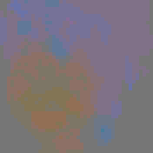
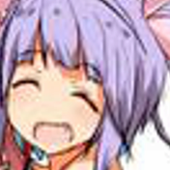
Introduction

Slide 3
Literature Reviews
Colorization
Classification
Regression
Image-to-Image translations
Unet architecture
Spectral Normalization + self-attention (didn’t work well for this project, need more time to understand it)
Color Space
RGB to LAB

Slide 4
experiment
Dataset
ImageNet Detection (fine tune the pre-train model)
ImageNet Video Detection (has 1.1 millions training data)
Aminiface(88K in training set and 22K in validation, provided by my classmate Bingbing Yang)

Slide 5
Experiment
Two Nvidia 1070 Gpus (8G)
Adam(betas = 0.9, 0.99)
learning rate = 1e-3 for the first two epochs, 1e-4 for the last three epochs
Batch_size = 24

Slide 6
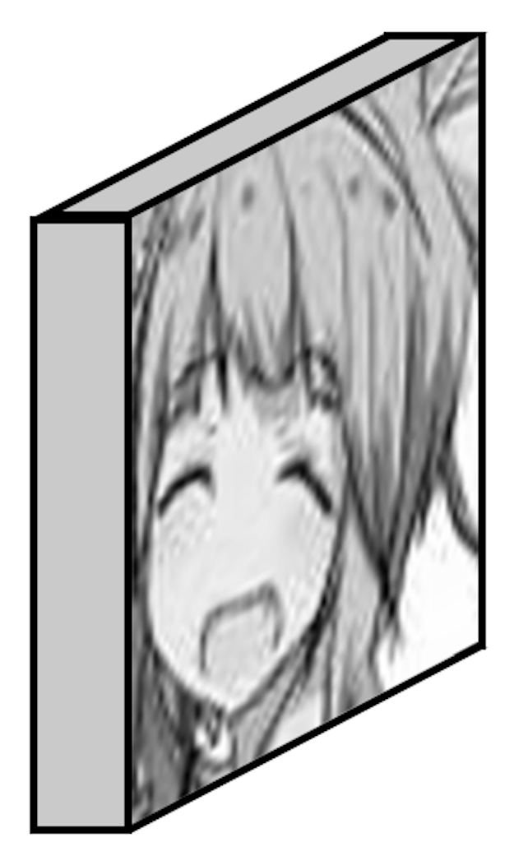
Experiment
:
256
512
512
512
512
256
128
128
64
64
Lightness
concat

Slide 7
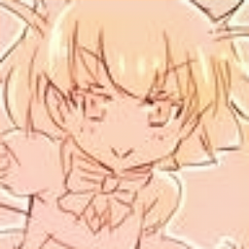
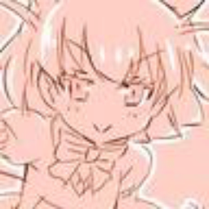
Results

Slide 8
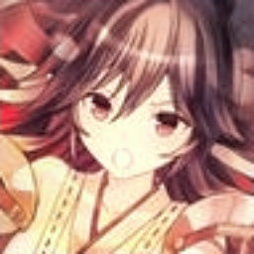
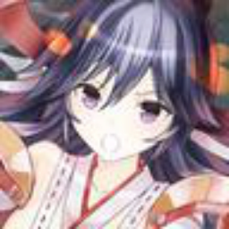
Results

Slide 9
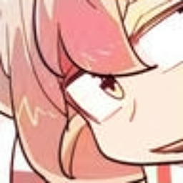

Results

Slide 10
Reference
Zhang, R., Isola, P., & Efros, A. A. (2016, October). Colorful image colorization. In European Conference on Computer Vision (pp. 649-666). Springer, Cham.
Zhang, R., Zhu, J. Y., Isola, P., Geng, X., Lin, A. S., Yu, T., & Efros, A. A. (2017). Real-time user-guided image colorization with learned deep priors. arXiv preprint arXiv:1705.02999.
Isola, P., Zhu, J. Y., Zhou, T., & Efros, A. A. (2017). Image-to-image translation with conditional adversarial networks. arXiv preprint.
Zhu, J. Y., Park, T., Isola, P., & Efros, A. A. (2017). Unpaired image-to-image translation using cycle-consistent adversarial networks. arXiv preprint.
Miyato, T., Kataoka, T., Koyama, M., & Yoshida, Y. (2018). Spectral normalization for generative adversarial networks. arXiv preprint arXiv:1802.05957.
Zhang, H., Goodfellow, I., Metaxas, D., & Odena, A. (2018). Self-Attention Generative Adversarial Networks. arXiv preprint arXiv:1805.08318.
Brock, A., Donahue, J., & Simonyan, K. (2018). Large scale gan training for high fidelity natural image synthesis. arXiv preprint arXiv:1809.11096.

